Slide 1
Module 2 - Output Primitives Topic: Boundary Fill Algorithm

Slide 2
Introduction
Boundary Fill Algorithm works inside out, the basic concept is filling the color in the closed area by starting at a point inside the region to be painted and working from inside towards the boundary.
One main constraint of the boundary fill algorithm is of having the boundary with one single color.

Slide 3
How it Works??
In Boundary fill algorithm, you start from a point inside the region and fill the color interior outward towards the boundary pixel by pixel.
So the process is that you check the color of the pixel before filling, if the color is not boundary color, then you fill it with the fill color, and move to the next pixel and check for the same criteria till you encounter the boundary colored pixel or the boundary.

Slide 4
Two Types of Implementation
There are two ways in which the Boundary Fill Algorithm can be implemented:
4-connected pixel
8-connected pixel

Slide 5
4 - Connected Pixel Fill
In 4 connected pixel method you check 4 pixels adjacent to the current pixel, namely towards the left, right, top & bottom are tested.
So you fill the area with 4-connected pixel method by following these steps

Slide 6
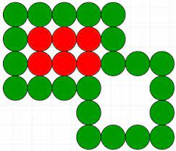
Steps for 4 - Connected Pixel Fill
First initialize the 4 values namely x, y, Fill color and Boundary Color. Where x and y are coordinate positions of the initial interior pixel we start the boundary fill algorithm & Fill-color is the color we want to fill.
Now check if the current pixel is not of boundary color and not of fill color then Repeat Step 3 and step 4 till the boundary pixels are reached.
Change the pixel color with the fill color at the current pixel.
Repeat steps 2 and step 3 for the neighboring 4 pixels.
Exit.

Slide 7
Algorithm for 4 - Connected Pixel Fill
boundary_fill_4(x, y, fill_color, boundary_color) int current;
current=getpixel (x, y);
if ( ( current != fill_color ) && ( current != boundary_color) )
{
setpixel (x, y, fill_color )
boundary_fill_4(x+1, y, fill_color , boundary_color); boundary_fill_4(x-1, y, fill_color , boundary_color); boundary_fill_4(x, y+1, fill_color , boundary_color); boundary_fill_4(x, y-1, fill_color , boundary_color);
}

Slide 8
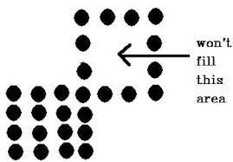
Problems with 4 - Connected Pixel Fill
It can’t check for all the neighbors and hence some regions might not get filled

Slide 9
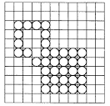
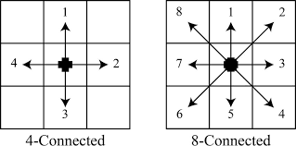
8 - Connected Pixel Fill
To solve the problems that can occur in 4 connected pixel method, a new method was introduced called 8-connected pixel.
In 8-connected pixel method, instead of filling just 4 adjacent pixels we fill also the adjacent diagonal pixels positions, such as
(x + 1 , y + 1)
(x + 1 , y - 1)
(x - 1 , y + 1)
(x - 1 , y - 1)

Slide 10
Algorithm for 4 - Connected Pixel Fill
boundary_fill_4(x, y, fill_color, boundary_color) int current;
current=getpixel (x, y);
if ( ( current != fill_color ) && ( current != boundary_color) )
{
setpixel (x, y, fill_color )
boundary_fill_4(x+1, y, fill_color , boundary_color); boundary_fill_4(x-1, y, fill_color , boundary_color); boundary_fill_4(x, y+1, fill_color , boundary_color); boundary_fill_4(x, y-1, fill_color , boundary_color);
}

Slide 11
Algorithm for 8 - Connected Pixel Fill
boundary_fill_8(x, y, fill_color, boundary_color) int current;
current=getpixel (x, y);
if ( ( current != fill_color ) && ( current != boundary_color) )
{
setpixel (x, y, fill_color )
boundary_fill_8(x+1, y, fill_color , boundary_color); boundary_fill_8(x-1, y, fill_color , boundary_color); boundary_fill_8(x, y+1, fill_color , boundary_color); boundary_fill_8(x, y-1, fill_color , boundary_color); boundary_fill_8(x+1, y+1, fill_color , boundary_color); boundary_fill_8(x+1, y-1, fill_color , boundary_color); boundary_fill_8(x-1, y+1, fill_color , boundary_color); boundary_fill_8(x-1, y-1, fill_color , boundary_color);
}

Slide 12
References
Hearn & Baker, “Computer Graphics C version”, 2nd Edition, Pearson Publication

